Slide 1


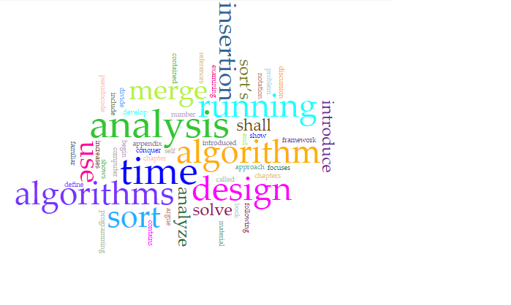
Discovering Hidden Cognitive Skill Dependencies between Knowledge Units Using Markov Cognitive Knowledge State Network(MCKSN).
Fatema Nafa
Dissertation Advisor: Prof. Javed Khan
Networking and Medianet Communications Research Laboratories
Department of Computer Science
Kent State University

Slide 2
Outline
Introduction
Motivation
Literature Review
Problem Definition
Proposed Solution
Experiment Results and Evaluation
Conclusion, Application, and limitations.
Future Work

Slide 3
Introduction
Humans are lifelong learners, and learning is a complex network. Scientists have developed many learning theories. One of the learning theory is Constructivism theory [Piaget 1957].
“The essential core of constructivism is that learners construct their own knowledge and meaning from their previous knowledge”. In other words, if you need to learn a new topic other previous topics need to be known. People incrementally build their learning.
One of the powerful ways of knowledge representation is a graph.
Constructivism theory provides a basis of representing learning knowledge as a graph.
Algorithm
Database
OS
Programming
Network
Calculus
Data Structure
Discreet
Notes:
Constructivism is a theory of learning that has roots in both philosophy and psychology.
The essential core of constructivism is that learners actively construct their own knowledge and meaning from their experiences (Fosnot, 1996; Steffe & Gale, 1995).
This core has roots that extend back through many years and many philosophers, including Dewey (1938), Hegel (1807/1949), Kant (1781/1946), and Vico (1725/1968).

Slide 4
Introduction
A new generation of work has used Constructivism theory in different application. An early work introduced by [Khan and Hardas, 2012] used the dependencies relationships between learning topics and used graph knowledge representation and demonstrated a powerful of learning analytics, with example application:
  Course and Learning Activities Design
  Knowledge based Test Design
  Assessment of Learning Activities Design
  Building Learning Map of Curriculum Area
Bloom’s taxonomy theory [Bloom,1956] proposed a taxonomy of learning skills in three domains:
  Cognitive (mental skills) Domain
  Affective (growth in feelings or emotional areas) Domain
  Psychomotor (manual or physical skills) Domain
Notes:
But one interesting question which we may ask is there skill levels of learning ??

Slide 5
Introduction
Using Bloom’s taxonomy there is work has done by [Khan and Aboalela 2017].They assumed that those cognitive domain levels are given then testing can be done to determine student's proficiency levels (specific to cognitive domain level) from student test result.
  For example, the analytics can answer, given a set of test questions, if student has learned what is Data Structure verses how to analyze Data Structure verses how to implement Data Structure .
Data Structure
Programming Language
C++
Definition
Python
Calculus
Types
Algorithm

Slide 6
Introduction
A major unsolved problem in the new paradigm of learning analytics is the automatic inference of cognitive domain relationship between domain-concepts.
Data Structure
Programming Language
OS
Apply
Understand
Algorithm
Database
Implement
Implement
Apply
Binary Tree
Programming

Slide 7
Outline
Introduction
Motivation
Literature Review
Problem Definition
Proposed Solution
Experiment Results and Evaluation
Conclusion, Application, and limitations.
Future Work

Slide 8
Related Works & Contribution into Perspective
Related Techniques
Related Theories and Models
Knowledge Discovery
Knowledge Representation
Constructivism Theory (Piaget 1957)
of
Concept Network Growth
Probability-Based Inference
Graph Based
Bloom Theory
Markov Logic Network(MLN)
WordNet
Bloom CD Taxonomy
Cognitive Domain
Revised Bloom Taxonomy
VerbNet
  Markov Cognitive Knowledge Sate Network (MKNSN)
SVD
Automatic CD Relation Identification
CS Taxonomy
Enhanced Applications
Course Design*
Teaching Methodology*
Test Problem Assessment*

Slide 9
Related Works & Contribution into Perspective
Related Techniques
Related Theories and Models
Knowledge Discovery
Knowledge Representation
Constructivism Theory (Piaget 1957)
of
Concept Network Growth
Probability-Based Inference
Graph Based
Bloom Theory
Markov Logic Network(MLN)
WordNet
Bloom CD Taxonomy
Cognitive Domain
Revised Bloom Taxonomy
VerbNet
  Markov Cognitive Knowledge Sate Network (MKNSN)
SVD
Automatic CD Relation Identification
CS Taxonomy
Enhanced Applications
Course Design*
Teaching Methodology*
There is good evidence that knowledge is represented some form of a cognitive concept network. Computer scientist has often assumed these concepts and relations to be discrete in nature and used artificial concept networks to represent cognitive knowledge [Khan and Hardas, 2012] .
Test Problem Assessment*

Slide 10
Related Works & Contribution into Perspective
Related Techniques
Related Theories and Models
Knowledge Discovery
Knowledge Representation
Constructivism Theory (Piaget 1957)
of
Concept Network Growth
Probability-Based Inference
Graph Based
Bloom Theory
Markov Logic Network(MLN)
WordNet
Bloom CD Taxonomy
Cognitive Domain
Revised Bloom Taxonomy
VerbNet
  Markov Cognitive Knowledge Sate Network (MKNSN)
SVD
Automatic CD Relation Identification
CS Taxonomy
Enhanced Applications
Course Design*
Teaching Methodology*
Test Problem Assessment*
Analyzing Test questions to know which cognitive level have students achieved [Khan and Aboalela, 2017].

Slide 11
Related Works & Contribution into Perspective
Related Techniques
Related Theories and Models
Knowledge Discovery
Knowledge Representation
Constructivism Theory (Piaget 1957)
of
Concept Network Growth
Probability-Based Inference
Graph Based
Bloom Theory
Markov Logic Network(MLN)
WordNet
Bloom CD Taxonomy
Cognitive Domain
Revised Bloom Taxonomy
VerbNet
  Markov Cognitive Knowledge Sate Network (MKNSN)
SVD
Automatic CD Relation Identification
CS Taxonomy
Enhanced Applications
Course Design*
Teaching Methodology*
Test Problem Assessment*
Bloom’s Taxonomy was applied on three computer science courses by [Machanick,2000] his experience was then analyzed, and he decided that Bloom’s Taxonomy-based approach works well.

Slide 12
Related Works & Contribution into Perspective
Related Techniques
Related Theories and Models
Knowledge Discovery
Knowledge Representation
Constructivism Theory (Piaget 1957)
of
Concept Network Growth
Probability-Based Inference
Graph Based
Bloom Theory
Markov Logic Network(MLN)
WordNet
Bloom CD Taxonomy
Cognitive Domain
Revised Bloom Taxonomy
VerbNet
  Markov Cognitive Knowledge Sate Network (MKNSN)
SVD
Automatic CD Relation Identification
CS Taxonomy
Enhanced Applications
Course Design*
No research has been done to automatic finding Bloom’s cognitive relationship between domain-concepts.
Teaching Methodology*
Test Problem Assessment*

Slide 13
Related Works & Contribution into Perspective
Related Techniques
Related Theories and Models
Knowledge Discovery
Knowledge Representation
Constructivism Theory (Piaget 1957)
of
Concept Network Growth
Probability-Based Inference
Graph Based
Bloom Theory
Markov Logic Network(MLN)
WordNet
Bloom CD Taxonomy
Cognitive Domain
Revised Bloom Taxonomy
VerbNet
  Markov Cognitive Knowledge Sate Network (MKNSN)
SVD
Automatic CD Relation Identification
CS Taxonomy
Verb Classification to identify the cognitive relationships
Enhanced Applications
Course Design*
Teaching Methodology*
Test Problem Assessment*

Slide 14
Related Works & Contribution into Perspective
Related Techniques
Related Theories and Models
Knowledge Discovery
Knowledge Representation
Constructivism Theory (Piaget 1957)
of
Concept Network Growth
Probability-Based Inference
Graph Based
Bloom Theory
Markov Logic Network(MLN)
WordNet
Bloom CD Taxonomy
Cognitive Domain
Revised Bloom Taxonomy
VerbNet
  Markov Cognitive Knowledge Sate Network (MKNSN)
SVD
Automatic CD Relation Identification
CS Taxonomy
Generating Cognitive Rules to infer the relationship
Enhanced Applications
Course Design*
Teaching Methodology*
Test Problem Assessment*

Slide 15
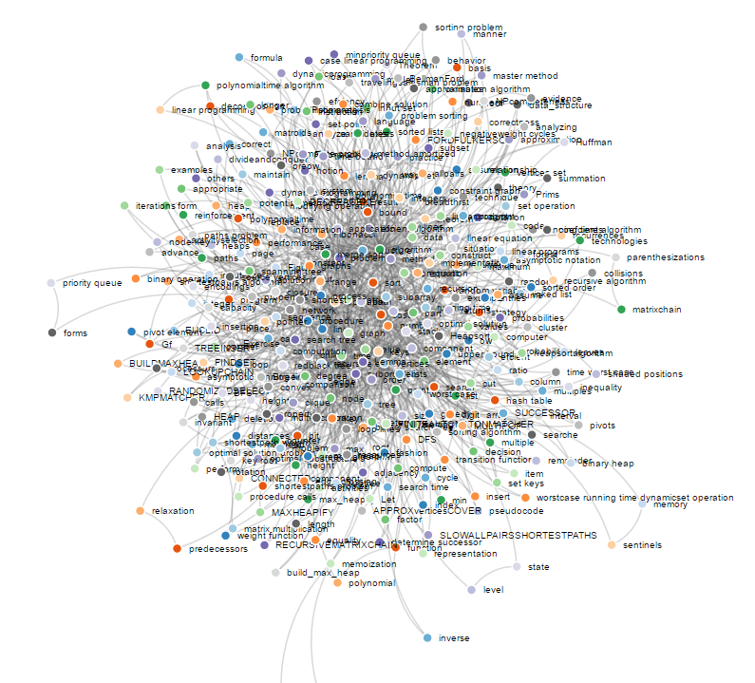
Contribution
Inferring Cognitive Relationship(Cognitive Skill Dependencies) CSD among Domain-Concepts.
    Reordering Bloom levels to be more flexible for Computer Science.
    Generating graph-based representation for the domain-concepts
    Cognitive based verb classification.

Slide 16
Outline
Introduction
Motivation
Literature Review
Problem Definition
Proposed Solution
Experiment Results and Evaluation
Conclusion, Application, and limitations.
Future Work

Slide 17
Problem Definition
Assumptions
Concept is the smallest unit in knowledge-unit. It is an element of a knowledge domain that is eventually acquired by learning the member concepts and their complex interrelationships.
In simple sentence, verbs typically indicate direct semantic relations between subject and object.
In complex sentence, concepts that nearest to the verb are semantically related.
We only consider knowledge-units of Computer Science domain.
The text used for extracting the relationships is structured, and in English.

Slide 18
Problem Definition
A Semantic Knowledge Map (SKM) is defined as a graph (C,E) where C is a set of KU, and E is a set of Cognitive Skill Dependencies (CSD) with their level specifications BL_{k} between the Knowledge-Units. Given a subset of CSDs, and a set of Skill Inference Rules (SIR), find out the hidden CSDs.
C₂
C₁
C₆
Apply
Analyze
Apply
C₄
C₇
C₅
Create
C₃
C₈
Apply
Analyze

Slide 19
Problem Definition
A Semantic Knowledge Map (SKM) is defined as a graph (C,E) where C is a set of KU and E is a set of Cognitive Skill Dependencies (CSD) with their level specifications BL_{k} between the Knowledge-Units. Given a subset of CSDs, and a set of Skill Inference Rules (SIR), find out the hidden CSDs.
C₂
C₁
C₆
C₄
C₇
C₅
C₃
C₈

Slide 20
Problem Definition
A Semantic Knowledge Map (SKG) is defined as a graph (C,E) where C is a set of KU and E is a set of Cognitive Skill Dependencies (CSD) with their level specifications BL_{k} between the Knowledge-Units. Given a subset of CSDs, and a set of Skill Inference Rules (SIR), find out the hidden CSDs.
C₂
Create
C₁
C₆
Apply
Analyze
Apply
C₄
C₇
C₅
Create
C₃
C₈
Apply
Analyze

Slide 21
Problem Definition
A Semantic Knowledge Map (SKG) is defined as a graph (C,E) where C is a set of KU and E is a set of Cognitive Skill Dependencies (CSD) with their level specifications BL_{k} between the Knowledge-Units. Given a subset of CSDs, and a set of Skill Inference Rules (SIR), find out the hidden CSDs.
C₂
Create
C₁
C₆
Apply
Analyze
Apply
C₄
C₇
C₅
Create
C₃
C₈
Apply
Analyze

Slide 22
Contribution
Inferring Cognitive Relationship(Cognitive Skill Dependencies) CSD among Domain-Concepts.
    Reordering Bloom levels to be more flexible for Computer Science.
    Generating graph-based representation for the domain-concepts
    Cognitive based verb classification.

Slide 23
Reordering Bloom levels
Bloom taxonomy cognitive domain involves knowledge and the development of intellectual skills [Bloom, 1956]. The cognitive domain is divided into six levels.
Revised Bloom taxonomy [Anderson,2001] cognitive domain is divided into six levels.
The Computer Science cognitive domain is divided into four levels[Nafa and Khan, 2015]
Evaluation
Creating
Creating
Synthesis
Evaluating
Evaluating and Analyzing
Analysis
Analyze
Application
Apply
Appling
Comprehension
Understanding
Remembering and Understanding
Knowledge
Remembering
Computer Science Bloom Taxonomy CSBT
Bloom’s Taxonomy
Revised Bloom’s Taxonomy
Notes:
Johnson and Fuller [27] found that colleagues disagreed about the relative difficulty of cognitive skills in computer science, so they redefined it into new cognitive skills levels.

Slide 24
Reordering Bloom levels
Johnson and Fuller found that they disagreed about the relative difficulty of cognitive tasks in computer science [Johnson and Fuller,2007].
Lahtinen’s recent work shows that the ordering of cognitive tasks in Bloom’s taxonomy is a very poor fit for the learning trajectories of some students tackling CS classes for the first time [Lahtinen,2007]
These problems led the working group [Fuller, Ursula, et al,2007] to investigate whether a subject specific taxonomy would be of more use to computer science instructors than the existing generic ones.
Creating
Evaluating and Analyzing
Appling
Remembering and Understanding
Computer Science Bloom Taxonomy CSBT
Notes:
Johnson and Fuller [27] found that colleagues disagreed about the relative difficulty of cognitive skills in computer science, so they redefined it into new cognitive skills levels.

Slide 25
Contribution
Inferring Cognitive Relationship(Cognitive Skill Dependencies) CSD among Domain-Concepts.
    Reordering Bloom levels to be more flexible for Computer Science.
    Generating graph-based representation for the domain-concepts
    Cognitive based verb classification.

Slide 26

Contribution
Textbook
Finding semantic relatedness among domain-concepts is divided into two sub problems.
The extraction of the domain-concept pairs
(C_{i}, C_{j}), and
The identification of verbs between each of two domain-concepts.
Sentences Extraction
Phrases Extraction
Tagging
Stemming
Stop Word Filtering
Domain-Concepts
Extract domain-concept pairs(KU)
Extract verbs
(Semantic Relatedness )

Slide 27
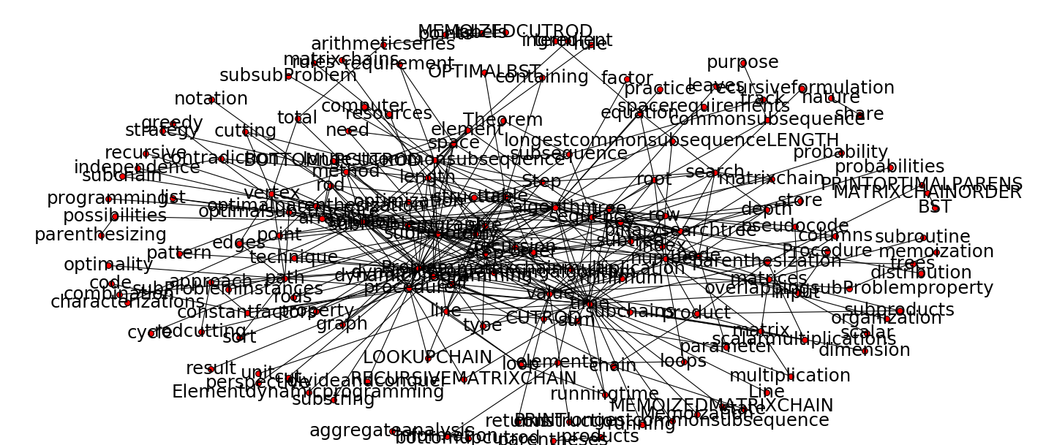
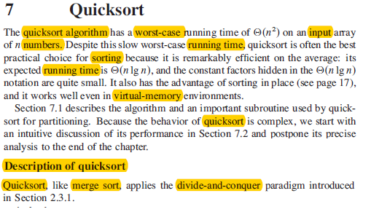
Contribution
Quicksort algorithm
Worst-Case
Merge -Sort
Input-Array
Running-Time
Divide-Conquer

Slide 28
Contribution
  The semantic relatedness is based on the hypothesis that the extraction of a semantic relatedness can be defined by the verbs frequently occurring in the neighborhood of pairs of domain-concepts associated with it.
  The pair of domain-concepts. and the verb are close (C₁, V, C₂) if its frequency of occurrence is greater than the expected frequency; then the verb (V) is considered as a candidate to determine the semantic relatedness between the concepts.
  All the verbs which occur above the expected frequency, along with the concepts, are considered as candidates for semantic relatedness among the concepts.

Slide 29
Contribution
Inferring Cognitive Relationship(Cognitive Skill Dependencies) CSD among Domain-Concepts.
    Reordering Bloom levels to be more flexible for Computer Science.
    Generating graph-based representation for the domain-concepts
    Cognitive based verb classification.

Slide 30
Cognitive based verb classification
Textbook
List of Extract Verbs
Sentences Extraction
Bloom Verb List
CS Verb List
Phrases Extraction
Tagging
Understanding
Applying
Analyzing
Creating
WordNet Synonym
Stemming
Stop Word Filtering
VerbNet Class
Domain Specific concepts
SVD
Extract Concept pairs (KU)
List of Extract Verbs
(Semantic Relatedness )
Verbs (Cognitive Skill Dependencies)

Slide 31
Cognitive based verb classification
Verb | Freq | Verb-Syn | B-Level
Access | 23 |  | ?
Accomplish | 22 |  | ?
Account | 7 |  | ?
Acquire | 11 |  | BL2
Add | 31 |  | BL1
Address | 20 |  | ?
Adopt | 10 |  | ?
allocate | 10 |  | BL2
Proof | 16 |  | ?
Analyze | 21 |  | BL3
Answer | 13 |  | ?
Delete | 37 |  | ?
Append | 16 |  | ?
Apply | 16 |  | BL2
Arrange | 32 |  | BL4
Assign | 5 |  | BL2
Associate | 28 |  | BL1
Assume | 33 |  | BL3
List of Extract Verbs
Bloom Verb List
CS Verb List
Understanding
Applying
Analyzing
Creating
WordNet Synonym
VerbNet Class
SVD

Slide 32
Cognitive based verb classification
Verb | Freq | Verb-Syn | B-Level
Access | 23 |  | ?
Accomplish | 22 |  | ?
Account | 7 |  | ?
Acquire | 11 |  | BL2
Add | 31 |  | BL1
Address | 20 |  | ?
Adopt | 10 |  | ?
allocate | 10 |  | BL2
Proof | 16 |  | ?
Analyze | 21 |  | BL3
Answer | 13 |  | ?
Delete | 37 |  | ?
Append | 16 |  | ?
Apply | 16 |  | BL2
Arrange | 32 |  | BL4
Assign | 5 |  | BL2
Associate | 28 |  | BL1
Assume | 33 |  | BL3
List of Extract Verbs
Bloom Verb List
CS Verb List
Understanding
Applying
Analyzing
Creating
WordNet Synonym
VerbNet Class
SVD

Slide 33
  Cognitive based verb classification
WordNet is a large database containing words and their definitions. Also it contains mapping between words, like synonyms and antonyms.
In this research, WordNet is used as a dictionary for verb synonym relations. Around 3,600 verb senses are included in WordNet.
Nouns
      Synonym ~ antonym (opposite of)
      Hypernyms (is a kind of) ~ hyponym (for example)
      Holonym (is part of) ~ meronym (has as part)
Verbs
      Synonym
      Hypernym ~ troponym (eg lisp – talk)
      Entailment (eg snore – sleep)
      Coordinate (sister) terms: share the same hypernym
Adjectives/Adverbs in addition to above
      Related nouns
      Verb participles
      Derivational information

Slide 34
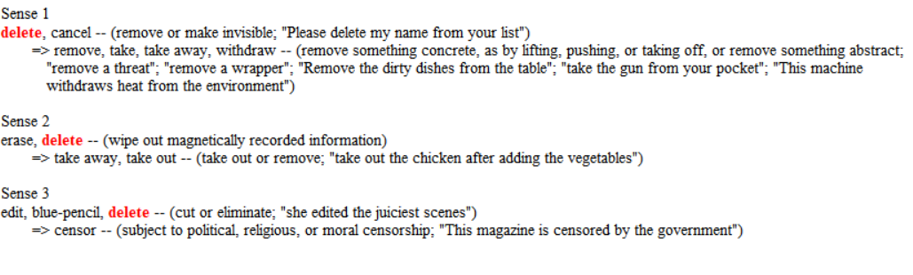
  Cognitive based verb classification
Verbs
      Synonym are words that have same meaning in some or all contexts.
  Example: Delete = Cancel.
[Miller, G. (1998). WordNet: An electronic lexical database: MIT press.]

Slide 35
  Cognitive based verb classification
Consider the words big and large
Are they synonyms?
  How big is that plane?
  Would I be flying on a large or small plane?
How about here:
  Miss Nelson became a kind of big sister to Benjamin.
  ?Miss Nelson became a kind of large sister to Benjamin.
Why?
  big has a sense that means being older, or grown up
  large lacks this sense

Slide 36
  Cognitive based verb classification
Verb | Freq | Verb-Syn | B-Level
Access | 23 |  | ?
Accomplish | 22 | Attain | BL1
Account | 7 | Calculate | BL2
Acquire | 11 |  | BL2
Add | 31 |  | BL1
Address | 20 |  | ?
Adopt | 10 |  | ?
allocate | 10 |  | BL2
Proof | 16 |  | ?
Analyze | 21 |  | BL3
Answer | 13 | Solution | BL4
Delete | 37 |  | ?
Append | 2 | Add | BL1
Apply | 16 |  | BL2
Arrange | 2 |  | BL4
Assign | 5 |  | BL2
Associate | 28 |  | BL1
Assume | 33 |  | BL3
List of Extract Verbs
Bloom Verb List
CS Verb List
Understanding
Applying
Analyzing
Creating
WordNet Synonym
VerbNet Class
SVD

Slide 37
  Cognitive based verb classification
Verb | Freq | Verb-Syn | B-Level
Access | 23 |  | ?
Accomplish | 22 | Attain | BL1
Account | 7 | Calculate | BL2
Acquire | 11 |  | BL2
Add | 31 |  | BL1
Address | 20 |  | ?
Adopt | 10 |  | ?
allocate | 10 |  | BL2
Proof | 16 |  | ?
Analyze | 21 |  | BL3
Answer | 13 | Solution | BL4
Delete | 37 |  | ?
Append | 2 | Add | BL1
Apply | 16 |  | BL2
Arrange | 2 |  | BL4
Assign | 5 |  | BL2
Associate | 28 |  | BL1
Assume | 33 |  | BL3
List of Extract Verbs
Bloom Verb List
CS Verb List
Understanding
Applying
Analyzing
Creating
WordNet Synonym
VerbNet Class
SVD

Slide 38
  VerbNet Class
VerbNet (VN) is a vast online repository for the classification of English verbs [Schuler, 2005].
The classification of VerbNet is based on the senses of verbs.
VerbNet covers 5,200 verb senses.
Each VerbNet class contains a set of syntactic descriptions.

Slide 39
  Cognitive based verb classification
Verb | Freq | Verb-Syn | B-Level
Access | 23 |  | ?
Accomplish | 22 | Attain | BL1
Account | 7 | Calculate | BL2
Acquire | 11 |  | BL2
Add | 31 |  | BL1
Address | 20 | Assume, Acquire | BL2,BL3
Adopt | 10 |  | ?
allocate | 10 |  | BL2
Proof | 16 |  | ?
Analyze | 21 |  | BL3
Answer | 13 | Solution | BL4
Delete | 37 |  | ?
Append | 2 | Add | BL1
Apply | 16 |  | BL2
Arrange | 2 |  | BL4
Assign | 5 |  | BL2
Associate | 28 |  | BL1
Assume | 33 |  | BL3
List of Extract Verbs
Bloom Verb List
CS Verb List
Understanding
Applying
Analyzing
Creating
WordNet Synonym
VerbNet Class
SVD

Slide 40
  Cognitive based verb classification
Verb | Freq | Verb-Syn | B-Level
Access | 23 |  | ?
Accomplish | 22 | Attain | BL1
Account | 7 | Calculate | BL2
Acquire | 11 |  | BL2
Add | 31 |  | BL1
Address | 20 | Assume, Acquire | BL2,BL3
Adopt | 10 |  | ?
allocate | 10 |  | BL2
Proof | 16 |  | ?
Analyze | 21 |  | BL3
Answer | 13 | Solution | BL4
Delete | 37 |  | ?
Append | 2 | Add | BL1
Apply | 16 |  | BL2
Arrange | 2 |  | BL4
Assign | 5 |  | BL2
Associate | 28 |  | BL1
Assume | 33 |  | BL3
List of Extract Verbs
Bloom Verb List
CS Verb List
Understanding
Applying
Analyzing
Creating
WordNet Synonym
VerbNet Class
SVD

Slide 41

  Singular Value Decomposition(SVD)
Latent Semantic Analysis (LSA) is a theory and method for extracting and representing the domain-concepts by using statistical computations [Golub & Reinsch, 1970].
The process is divided into two tasks:
  Creating a Metrix, and
  Calculating SVD.
$$\text{A}\text{ = }\text{US} \text{V}\text{T}$$

Slide 42
  Cognitive based verb classification
Verb | Freq | Verb-Syn | B-Level
Access | 23 | Code | BL2
Accomplish | 22 | Attain | BL1
Account | 7 | Calculate | BL2
Acquire | 11 |  | BL2
Add | 31 |  | BL1
Address | 20 | Assume, Acquire | BL2,BL3
Adopt | 10 | Follow | BL1
allocate | 10 |  | BL2
Proof | 16 | Create | BL4
Analyze | 21 |  | BL3
Answer | 13 | Solution | BL4
Delete | 37 | Cancel | BL1
Append | 2 | Add | BL1
Apply | 16 |  | BL2
Arrange | 2 |  | BL4
Assign | 5 |  | BL2
Associate | 28 |  | BL1
Assume | 33 |  | BL3
List of Extract Verbs
Bloom Verb List
CS Verb List
Understanding
Applying
Analyzing
Creating
WordNet Synonym
VerbNet Class
SVD

Slide 43
  Cognitive based verb classification

Slide 44
Contribution
Inferring Cognitive Relationship(Cognitive Skill Dependencies) CSD among Domain-Concepts.
    Reordering Bloom levels to be more flexible for Computer Science.
    Generating graph-based representation for the domain-concepts
    Cognitive based verb classification.

Slide 45
Outline
Introduction
Motivation
Literature Review
Problem Definition
Proposed Solution
Experiment Results and Evaluation
Conclusion, Application, and limitations.
Future Work

Slide 46
Proposed Solution
Markov Cognitive Knowledge State Network (MCKSN)
A Markov Cognitive Knowledge State Network (MCKSN) is defined as an undirected graph G= (C, E), where each node c_{i} in the node set C represents a fact at a given CSD. E ⊆ C×C is a set of edges connecting the nodes. Each edge e_{i,j} represents the appearance of the facts in the same skill inference rule(SIR).
Apply(A,B)
Create(B,C)
CSD
SIR
Create(A,C)

Slide 47
Markov Cognitive Knowledge State Network (MCKSN)
Markov Cognitive Knowledge State Network
Generating Skill Inference Rules
Markov Network
knowledge is represented as skill inference rules, and new facts are derived by using logic equivalencies.
The facts are seen as random variables in Markov Network to express propositional logic rules.

Slide 48
Markov Cognitive Knowledge State Network (MCKSN)
Markov Cognitive Knowledge State Network
Generating Skill Inference Rules
Markov Network
knowledge is represented as skill inference rules, and new facts are derived by using logic equivalencies.
The facts are seen as random variables in Markov Network to express propositional logic rules.

Slide 49
Generating Skill Inference Rules
Apply(x, z) ∧ Create(z, y) => Apply (x, y)
Z
IF
X
Known
To Apply
Z
To Apply
To Create
And
Z
Known
To Create
Y
X
Y
Then
X
needed
To Apply
Y
To Apply
Apply(x,z) ∧ Create(z, y) => Apply (x, y)
There is no magic coding recipe for taking a sentence expressed in natural language or any other form and showing it in First-Order Logic.
Generating SIR by using If-then logic rules.
Notes:
This section explains the First Order Logic (FOL) representation used to construct SIR from SKM. Translating SKM to SIR by using If-then rules are applied to SKM. The cognitive verb levels among concepts are extracted. Then, the lexical database is used to extract WordNet (WN) relationship among concepts obtained. The SKM represents the connection between concepts in form of WordNet and Cognitive relationships (Guo et al., 2016).

Slide 50
Markov Cognitive Knowledge State Network (MCKSN)
Markov Cognitive Knowledge State Network
Generating Skill Inference Rules
Markov Network
knowledge is represented as skill inference rules, and new facts are derived by using logic equivalencies.
The facts are seen as random variables in Markov Network to express propositional logic rules.

Slide 51

Converting SKM into MCKSN through CSD(facts) and SIR where the facts describe cognitive relationships between two nodes and the SIR describe cognitive relationships among three nodes which is form a clique in MCKSN.
Apply
Graph(G)
Binary Tree
BFS
Apply(G,GT)
Apply
$$≈$$
Analyze
Apply
Create
Data Structure
Graph Traverse(GT)
Heapsort
Algorithm
Insertion sort
Apply
Analyze
SKM
MCKSN

Slide 52

Converting SKM into MCKSN through CSD facts and SIR where the facts describe cognitive relationships between two nodes and the SIR describe cognitive relationships among three nodes which is form a clique in MCKSN.
Apply
Graph(G)
Binary Tree
BFS
Apply(G,GT)
Apply
Create
$$≈$$
Analyze
Apply
Create(GT,BFS)
Data Structure
Graph Traverse(GT)
Heapsort
Algorithm
Insertion sort
Apply
Analyze
SKM
MCKSN

Slide 53
Converting SKM into MCKSN through CSD facts and SIR where the facts describe cognitive relationships between two nodes and the SIR describe cognitive relationships among three nodes which is form a clique in MCKSN.
Apply
Graph(G)
Binary Tree
BFS
Apply(G,GT)
Apply
Create
$$≈$$
Analyze
Apply
Data Structure
Graph Traverse(GT)
Heapsort
Apply (G,BFS)
Create(GT,BFS)
Algorithm
Insertion sort
Apply
Analyze
SKM
MCKSN

Slide 54

Converting SKM into MCKSN through CSD facts and SIR where the facts describe cognitive relationships between two nodes and the SIR describe cognitive relationships among three nodes which is form a clique in MCKSN.
Apply
Graph(G)
Binary Tree
BFS
Apply(G,GT)
Create
$$≈$$
Apply
Data Structure
Graph Traverse(GT)
Heapsort
Apply (G,BFS)
Create(GT,BFS)
Algorithm
Insertion sort
Create(x,y) ∧ Apply(y, z) => Create (z, x)

Slide 55
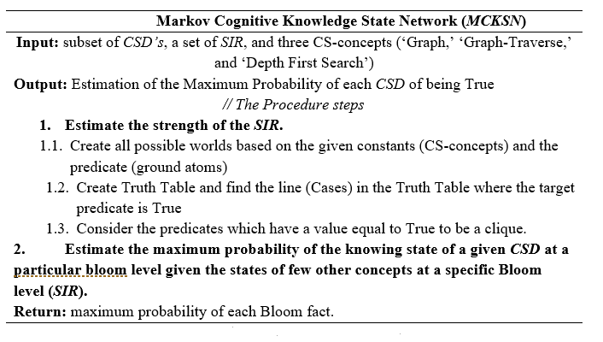
Markov Cognitive Knowledge State Network (MCKSN)

Slide 56
Markov Cognitive Knowledge State Network (MCKSN)

Slide 57
Markov Cognitive Knowledge State Network (MCKSN)

Slide 58
Markov Cognitive Knowledge State Network (MCKSN)
(Create(z, x)^Apply(z, y) ) => Create(x, y)
S
The number of possible ground atoms for each relation = n^{r}, where n: number of constants, and r: number of relations.
Example:
If we have 3 entities(Constants): Graph, Graph Traverse and BFS.
And we have 2 relations: Create, Apply
Number of possible ground atoms for each relation = 3² = 9
The total number of ground atoms = 93 =27 ground atoms.

Slide 59
Markov Cognitive Knowledge State Network (MCKSN)
Créate(z, x) ∧ Apply (z, y) => Créate(x, y)
Z | X | Y | Atomic Formula
Graph | Graph | Graph | CR(Graph, Graph)^AP(Graph, Graph) ) => CR (Graph, Graph)
 | Graph | BFS | CR(Graph, Graph)^AP(Graph, BFS) => CR (Graph, BFS)
 | Graph | Graph Traverse | CR(Graph, Graph)^AP(Graph, GT ) => CR (Graph, GT )
 | BFS | BFS | CR(Graph, BFS)^AP(Graph, BFS ) => CR (BFS, BFS )
 | BFS | Graph | CR(Graph, BFS)^AP(Graph, GT ) => CR (BFS, GT)
 | BFS | Graph Traverse | CR(Graph, Graph)^AP(Graph, Graph) ) => CR (Graph, Graph)
 | Graph Traverse | Graph Traverse | CR(Graph, GT)^AP(Graph, GT) ) => CR (GT,GT)
 | Graph Traverse | BFS | CR(Graph, GT)^AP(Graph, BFS) ) => CR (GT, BFS)
 | Graph Traverse | Graph | CR(Graph, GT)^AP(Graph, Graph) ) => CR (GT, Graph)
BFS | BFS | BFS | CR(BFS, BFS)^AP(BFS, BFS) ) => CR (BFS, BFS)
 | BFS | Graph | CR(BFS, BFS)^AP(BFS, Graph)) ) => CR (BFS, Graph)
 | BFS | Graph Traverse | CR(BFS, BFS)^AP(BFS, GT ) => CR (BFS, GT)
 | Graph | BFS | CR(BFS, Graph)^AP(BFS, BFS) ) => CR (Graph, BFS)
 | Graph | Graph | CR(BFS, Graph)^AP(BFS, Graph) ) => CR (Graph, Graph)
 | Graph | Graph Traverse | CR(BFS, Graph)^AP(BFS, GT) ) => CR (Graph,GT)
 | Graph Traverse | Graph Traverse | CR(BFS, GT)^AP(BFS, GT) ) => CR (GT,GT)
 | Graph Traverse | BFS | CR(BFS, GT)^AP(BFS, BFS) ) => CR (GT, BFS)
 | Graph Traverse | Graph | CR(BFS, GT)^AP(BFS, Graph) ) => CR (GT,Graph)
Graph Traverse | Graph Traverse | Graph Traverse | CR(GT, GT)^AP(GT, GT ) => CR (GT, GT)
 | Graph Traverse | BFS | CR(GT, GT)^AP(GT, BFS) => CR (GT, BFS)
 | Graph Traverse | Graph | CR(GT, GT)^AP(GT, Graph ) => CR (Graph, GT )
 | BFS | BFS | CR(GT, BFS)^AP(GT, BFS ) => CR (BFS, BFS )
 | BFS | Graph | CR(GT, BFS)^AP(GT, Graph ) => CR (BFS, Graph)
 | BFS | Graph Traverse | CR(GT, BFS)^AP(GT, GT ) => CR (BFS,GT)
 | Graph | BFS | CR(GT, Graph)^AP(GT, BFS) ) => CR (Graph,BFS)
 | Graph | Graph | CR(GT,Graph)^AP(GT,Graph) ) => CR (Graph,Graph)
 | Graph | Graph Traverse | CR(GT, Graph)^AP(GT, GT ) => CR (Graph,GT)

Slide 60
Markov Cognitive Knowledge State Network (MCKSN)

Slide 61
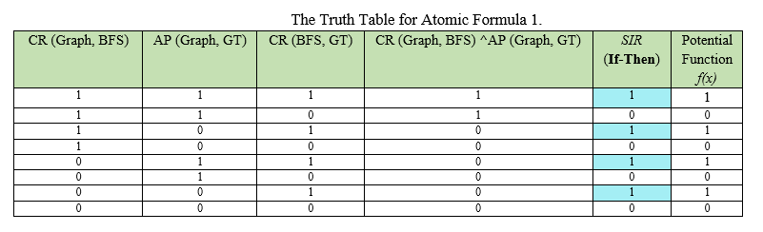
Markov Cognitive Knowledge State Network (MCKSN)
(Create(z, x)^Apply(z, y) ) => Create(x, y)

Slide 62
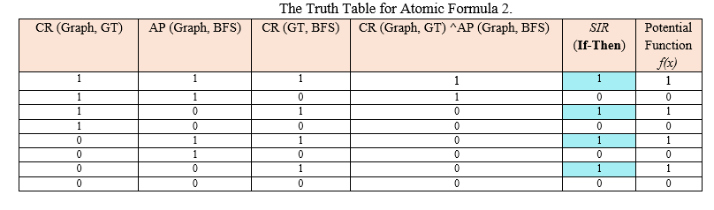
Markov Cognitive Knowledge State Network (MCKSN)
(Create(z, x)^Apply(z, y) ) => Create(x, y)

Slide 63
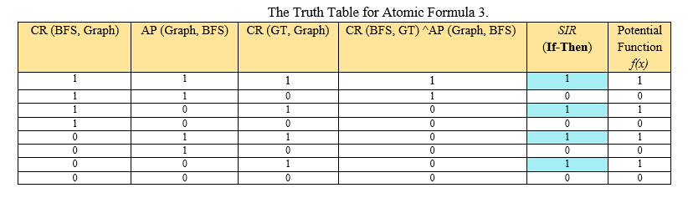
Markov Cognitive Knowledge State Network (MCKSN)
(Create(z, x)^Apply(z, y) ) => Create(x, y)

Slide 64
Markov Cognitive Knowledge State Network (MCKSN)

Slide 65
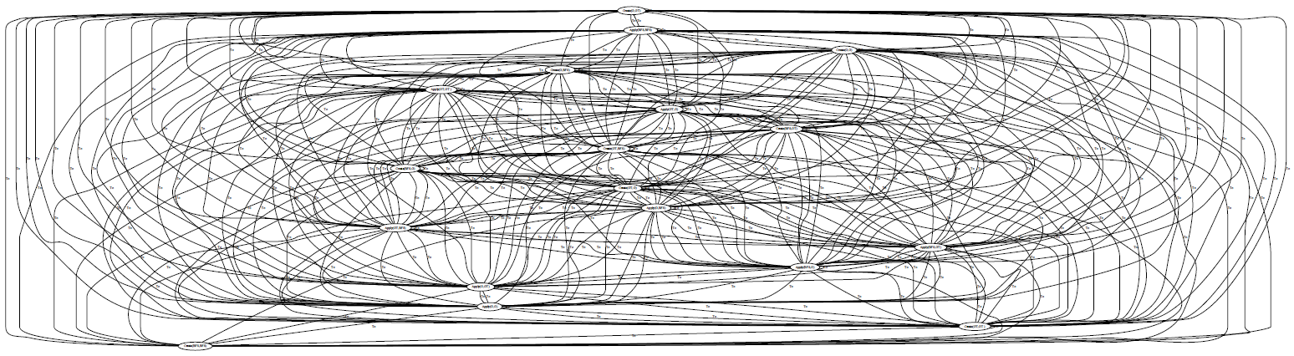
Create(G,GT)
Apply(G,GT)
Apply(GT,GT )
Create(G,BFS)
Create(BFS,GT)
Create(G,G)
Apply(BFS,GT)
Apply(BFS,BFS)
Apply(BFS,G)
Apply(GT,G)
Create(BFS,G)
Apply(G,BFS)
Create(GT,BFS)
Create(GT,GT )
Apply(GT,BFS)
Apply(G,G)
Create(GT,G)
Create(BFS,BFS)
Create (G, BFS) ^ Apply(G, GT) => Create(BFS,GT)

Slide 66
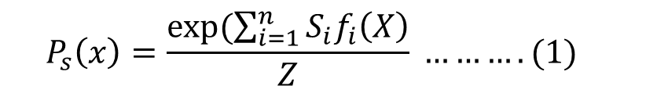

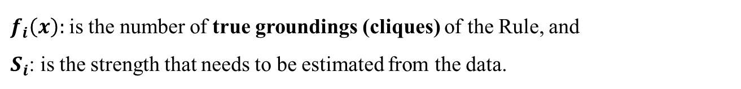
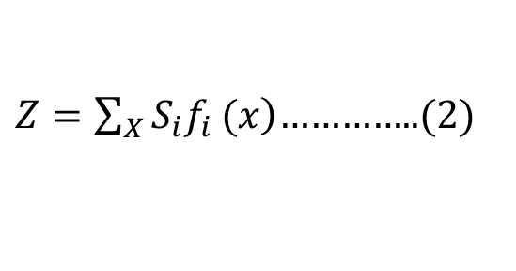
Markov Cognitive Knowledge State Network (MCKSN)
Estimate the strength of the Rule.
$$P_{s}\left(x\right)=\frac{exp⁡(\sum_{i=1}^{n}{S_{i}f_{i}\left(X\right)}}{Z} ……….(1)$$
$\left.Z=\sum_{X}{S_{i}f_{i}}(x\right)$…………..(2)
where:
$f_{i}\left(x\right):$is the number of true groundings (cliques) of the Rule, and
$S_{i}$: is the strength that needs to be estimated from the data.
$P_{s}\left(x\right)=\frac{e^{12s}}{4 e^{3s }+ 4}$…………(3)

Slide 67

Markov Cognitive Knowledge State Network (MCKSN)
$P_{s}\left(x\right)=\frac{e^{12s}}{4 e^{3s }+ 4}$…………(3)
Equation(3) cannot be solved in closed form, but it can be found using an optimization gradient descent method known as the Broyden-Fletcher-Goldfarb-Shanno (BFGS) optimization algorithm (Biegler, 2010; Hasdorff, 1976; Jahn, 2007).
(Create(z, x)^Apply(z, y) ) => Create(x, y)
12.69

Slide 68
Markov Cognitive Knowledge State Network (MCKSN)

Slide 69
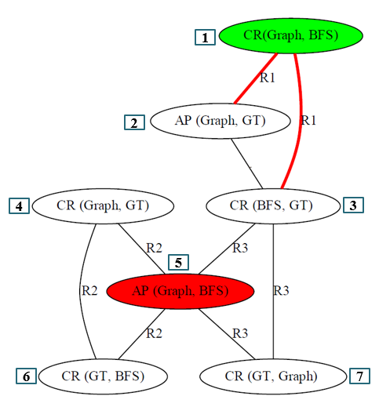
CR(Graph, BFS) | AP(Graph, GT ) | CR(BFSGT)
1 | 1 | 1
0 | 1 | 1
0 | 1 | 1
1 | 1 | 1
0 | 1 | 1
0 | 1 | 1
0 | 1 | 1
1 | 1 | 1
To estimate the maximum probability, each node in the graph is updated iteratively according to the probability of that node given its Markov blanket.
One cycle is completed when we have done iterating over all nodes.
In this example we start with node Number 1.
Given the value of evidence node, which is the Red node.
Notes:
Where f_{i} is the set of ground formulas that x appears in, the MB(x) Markov blanket of node x,
and f_{i}(x=1) and f_{i}(x=0) are the values (0 or 1) of the feature corresponding to the ith ground formula.

Slide 70
CR(Graph, BFS) | AP(Graph, GT ) | CR(BFSGT)
1 | 1 | 1
0 | 1 | 1
0 | 1 | 1
1 | 1 | 1
0 | 1 | 1
0 | 1 | 1
0 | 1 | 1
1 | 1 | 1
Gibbs Sampling
Start with an initial random assignment to nodes
One node at a time, sample node given its Markov blanket
Repeat
Use samples to compute P(X)
Apply to the ground network
Notes:
Where f_{i} is the set of ground formulas that x appears in, the MB(x) Markov blanket of node x,
and f_{i}(x=1) and f_{i}(x=0) are the values (0 or 1) of the feature corresponding to the ith ground formula.

Slide 71

CR(Graph, BFS) | AP(Graph, GT ) | CR(BFSGT)
1 | 1 | 1
0 | 1 | 1
0 | 1 | 1
1 | 1 | 1
0 | 1 | 1
0 | 1 | 1
0 | 1 | 1
1 | 1 | 1
CR (Graph, BFS) is equal to:
P(CR (BFS, GT)=0 |CR(Graph, BFS)=1, AP(Graph, GT )=1, AP(BFS, Graph)=1, CR (GT, Graph)=1
P(CR (BFS, GT)=1 |CR(Graph, BFS)=1, AP(Graph, GT )=1, AP(BFS, Graph)=1, CR (GT, Graph)=1
Notes:
Where f_{i} is the set of ground formulas that x appears in, the MB(x) Markov blanket of node x,
and f_{i}(x=1) and f_{i}(x=0) are the values (0 or 1) of the feature corresponding to the ith ground formula.

Slide 72

CR(Graph, BFS) | AP(Graph, GT ) | CR(BFSGT)
1 | 1 | 1
0 | 1 | 1
0 | 1 | 1
1 | 1 | 1
0 | 1 | 1
0 | 1 | 1
0 | 1 | 1
1 | 1 | 1
P(CR (Graph, BFS)) is equal to:
Notes:
Where f_{i} is the set of ground formulas that x appears in, the MB(x) Markov blanket of node x,
and f_{i}(x=1) and f_{i}(x=0) are the values (0 or 1) of the feature corresponding to the ith ground formula.

Slide 73
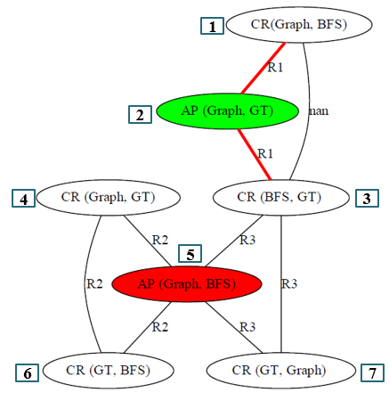
Markov Cognitive Knowledge State Network (MCKSN)
CR(Graph, BFS) | AP(Graph, GT ) | CR(BFSGT)
1 | 1 | 1
1 | 0 | 1
1 | 1 | 1
1 | 0 | 1
1 | 1 | 1
1 | 0 | 1
1 | 1 | 1
1 | 1 | 1

Slide 74
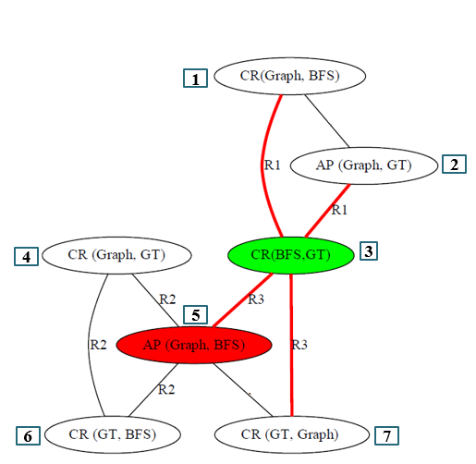
Markov Cognitive Knowledge State Network (MCKSN)
CR(Graph, BFS) | AP(Graph, GT ) | CR(BFS, BFS) | CR(GT,Graph) | CR(Graph,BFS)
1 | 1 | 1 | 1 | 1
1 | 1 | 0 | 1 | 1
1 | 1 | 0 | 1 | 1
1 | 1 | 1 | 1 | 1
1 | 1 | 1 | 1 | 1
1 | 1 | 1 | 1 | 1
1 | 1 | 1 | 1 | 1
1 | 1 | 1 | 1 | 1

Slide 75
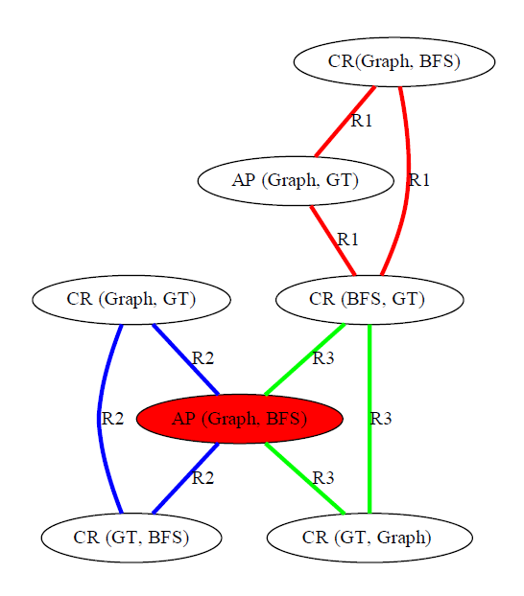
Markov Cognitive Knowledge State Network (MCKSN)
0.497000
0.500476
0.483333
0.514167
0.499009
0.502407
0.560000
0.7976
1.00000
1.00000
0.483333
0.520000
0.501154
0.502067

Slide 76
Markov Cognitive Knowledge State Network (MCKSN)
Inferred CSD | Iteration-1 | Iteration-2 | Iteration-3 | Iteration-4 | Iteration-10
CREATE(Graph, BFS) | 0.497000 | 0.535000 | 0.502941 | 0.504444 | 0.700476
APPLY(Graph, GT) | 0.483333 | 0.500000 | 0.506667 | 0.501176 | 0.814167
CREATE(BFS, GT) | 0.502407 | 0.502482 | 0.5902482 | 0.692411 | 0.7976
CREATE(Graph, GT) | 0.499009 | 0.497163 | 0.497163 | 0.4956 | 0.560000
APPLY(Graph, BFS) | 1 | 1 | 1 | 1 | 1
CREATE(GT,BFS) | 0.483333 | 0.482222 | 0.484167 | 0.490000 | 0.501154
CREATE(GT, Graph) | 0.520000 | 0.520000 | 0.528333 | 0.502067 | 0.502067

Slide 77
Outline
Introduction
Motivation
Literature Review
Problem Definition
Proposed Solution
Experiment Results and Evaluation
Conclusion, Application, and limitations.
Future Work

Slide 78
Experiment Results and Evaluation
Setting
  An experiment was conducted on Introduction to Algorithms, a standard popular textbook used in Computer Science.
  Twenty-Two CS domain-concepts were used in this experiment.
  The implementation of the MCKSN model is based on using pracMLN, an MLN python package for statistical relational learning and reasoning (Ankan & Panda, 2015).
  Automated results evaluated by 120 graduate and undergraduate students.

Slide 79
Experiment Results and Evaluation

Slide 80
Experiment Results and Evaluation
True Positive (TP) rate measures the fraction of positive cognitive skill dependencies that are correctly labeled as positive by both human and MKNSK

Slide 81
Experiment Results and Evaluation
False Negative (FN) measures the fraction of cases that are misclassified of cognitive skill dependencies by MCKSN

Slide 82
Experiment Results and Evaluation
False Positive (FP) measures the fraction of cases that are misclassified of cognitive skill dependencies

Slide 83
Experiment Results and Evaluation
True Negative (TN) rate measures the fraction of positive cognitive skill dependencies that are labeled as negative.

Slide 84
Experiment Results and Evaluation
The MCKSN model is suitable for the research problem and makes well behavior to estimate the cognitive skill dependency (understanding).
Meanwhile, the pattern of the misclassification rates in the False Positive (FP) and False Negative (FN) were low.
Notes:
The MCKSN model is suitable for the research problem and makes well behavior to estimate the cognitive skill dependency (understanding). Meanwhile, the pattern of the misclassification rates in the False Positive (FP) and False Negative (FN) were low. Overall, the higher the number of the accurateness parameters (TP and TN), the more correct the estimation of cognitive skill dependencies; the reverse occurred with respect to incorrect classification.

Slide 85
Experiment Results and Evaluation

Slide 86
Experiment Results and Evaluation

Slide 87
Experiment Results and Evaluation

Slide 88
Experiment Results and Evaluation
Precision(P): this is a factor to measure how much of the MCKSN model’s guess was correct (Grishman & Sundheim, 1996).
Recall(R): this is used as a performance metric when the MCKSN model predicts yes, and it is actually correct.
Accuracy(D): it is most commonly defined over all the classification errors that are made (Powers, 2011).
F-measure: this is a measure that uses both the precision and recall when testing the accuracy.

Slide 89
Experiment Results and Evaluation
The MCKSN model was successful in obtaining an accuracy(D) of 81% and 80%
Notes:
all the measured values were obtained by the MCKSN model using two different scaling techniques.
The MCKSN model was successful in obtaining a Precision(P) of 81%, a Recall(R) of 100%, an accuracy(D) of 81%, and an F-measure of 86% for the MinMax scaling technique; and a Precision (P') of 95%, a Recall(R') of 100%, an accuracy(D') of 95%, and an F'-measure of 97% for the Log scaling technique.

Slide 90
Experiment Results and Evaluation
The MCKSN model was successful in obtaining a Recall(R) of 62% and 82%
Notes:
all the measured values were obtained by the MCKSN model using two different scaling techniques.
The MCKSN model was successful in obtaining a Precision(P) of 81%, a Recall(R) of 100%, an accuracy(D) of 81%, and an F-measure of 86% for the MinMax scaling technique; and a Precision (P') of 95%, a Recall(R') of 100%, an accuracy(D') of 95%, and an F'-measure of 97% for the Log scaling technique.

Slide 91
Experiment Results and Evaluation
The MCKSN model was successful in obtaining an F-measure of 78% and 83%
Notes:
all the measured values were obtained by the MCKSN model using two different scaling techniques.
The MCKSN model was successful in obtaining a Precision(P) of 81%, a Recall(R) of 100%, an accuracy(D) of 81%, and an F-measure of 86% for the MinMax scaling technique; and a Precision (P') of 95%, a Recall(R') of 100%, an accuracy(D') of 95%, and an F'-measure of 97% for the Log scaling technique.

Slide 92
Experiment Results and Evaluation
The MCKSN model was successful in obtaining a Precision(P) of 98% and 83%.
Notes:
all the measured values were obtained by the MCKSN model using two different scaling techniques.
The MCKSN model was successful in obtaining a Precision(P) of 81%, a Recall(R) of 100%, an accuracy(D) of 81%, and an F-measure of 86% for the MinMax scaling technique; and a Precision (P') of 95%, a Recall(R') of 100%, an accuracy(D') of 95%, and an F'-measure of 97% for the Log scaling technique.

Slide 93
Experiment Results and Evaluation
Notes:
all the measured values were obtained by the MCKSN model using two different scaling techniques. The MCKSN model was successful in obtaining a Precision(P) of 81%, a Recall(R) of 100%, an accuracy(D) of 81%, and an F-measure of 86% for the MinMax scaling technique; and a Precision (P') of 95%, a Recall(R') of 100%, an accuracy(D') of 95%, and an F'-measure of 97% for the Log scaling technique.

Slide 95
Experiment Results and Evaluation

Slide 96
Experiment Results and Evaluation
Cognitive Skill Dependencies Level | Margin of Errors | Confidence Level
Understanding | 3.56% | 95%
Applying | 3.58% | 95%
Analyzing and Evaluating | 3.78% | 95%
Creating | 4.33% | 95%

Slide 97
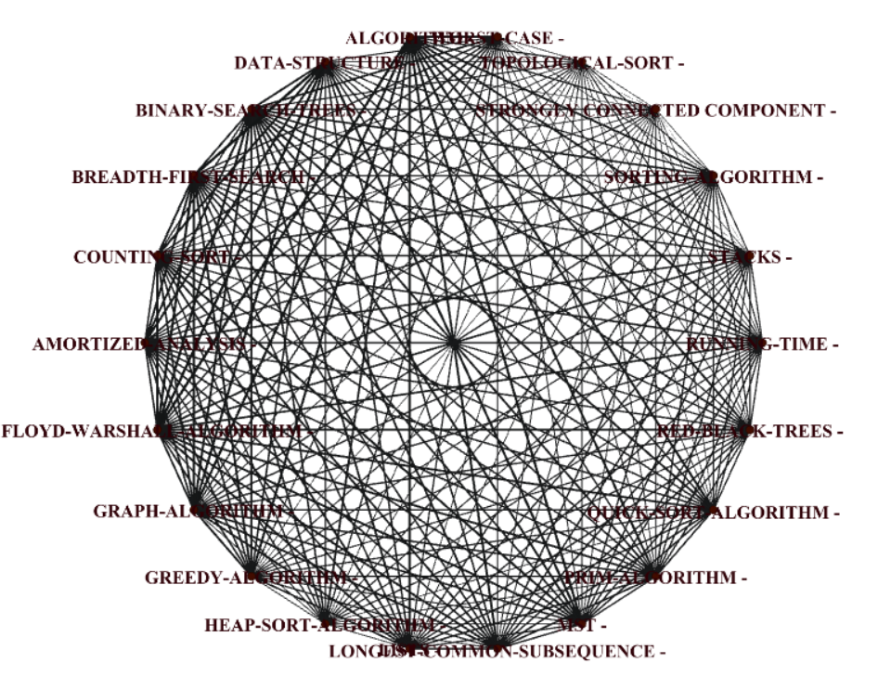
Biredview of the inferred Cognitive Skill Dependencies (Understanding) using MCKSN Model at threshold β_{m} =50%.

Slide 98
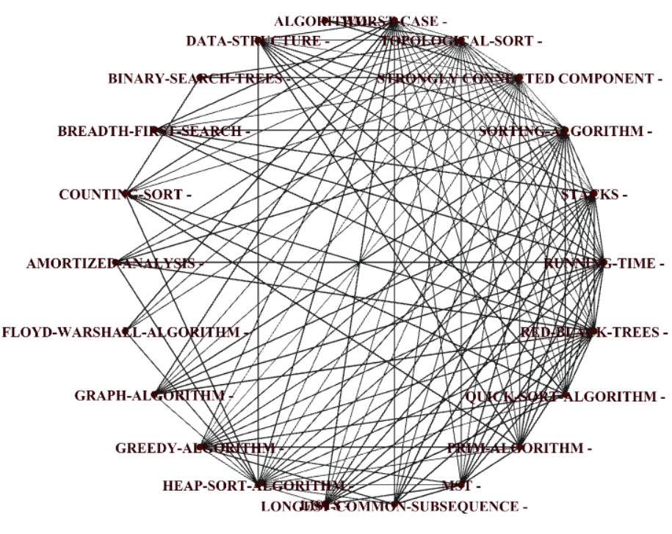
Biredview of the inferred Cognitive Skill Dependencies (Understanding) using MCKSN Model at threshold β_{m} =85%.

Slide 100
CS-Understanding level
  The learner is expected to know the definition, general class, and properties and characteristics of the concepts. Understanding means that learner can memorize and repeat the definition, key properties and their values.
For example:
Understanding the concept “Algorithm”
Definition: An algorithm is a set of instructions designed to perform a specific task.
General Class: algorithms are often created as function. These functions serve as small programs that can be referenced by a larger program.
General Characteristics: the algorithm receives input and produces output.
Creating
Evaluating and Analyzing
Appling
Remembering and Understanding

Slide 101
CS-Applying level
  To apply concept learner must know the functional properties of the concept, Environment and real-world constraints.
For Example:
Appling Dived and conquer strategy to solve merge sort problem.
Functional properties : Divide array into two halves.
Environment : Time for sorting, Memory space,etc.
Creating
Evaluating and Analyzing
Appling
Remembering and Understanding

Slide 102
CS-Analyzing level
  The learner must have an ability to understand the composition of a concept, determine how the components relate to each other, as well as the differences between them.
For Example:
Analyzing the concept “Heap sort”
Composition : one must know heap, stack and inputs.
Differences between them : When we need to use it and why? If we don't need a stable sort and we care more about worst case performance than average case performance
Creating
Evaluating and Analyzing
Appling
Remembering and Understanding

Slide 103
CS-Creating level
  what is needed to create concept?
  For most target driven creations (regardless if it is of an engineering nature),
  the specific application is the motivation.
Creating
Evaluating and Analyzing
Appling
Remembering and Understanding

Slide 104
Outline
Introduction
Motivation
Literature Review
Problem Definition
Proposed Solution
Evaluation
Result
Conclusion, Application, and limitations.
Future Work

Slide 105
Conclusion
  An interesting angle to rank the learning materials by level of understanding in terms of the cognitive skill dependencies between domain-concepts.
  We recommended to use the initial version of our model to introduce varity of options starting from measuring the knowledge in a textbook, which is affect both the quality of the knowledge acquired and the time needed to learn this knowledge

Slide 106
Application
The model will serve the following application:
  Extracting teaching plan for instructors based on cognitive skill dependencies between concepts.
  Inferring the learning objectives of a course based on cognitive skill dependencies.
  Introducing a learning map for CS learners.
  Generating a summary template from the learning materials based on the most discussion topics in the textbook.

Slide 107
  Limitations
Here the limitations of the current model are presented. These limitations are not fundamental to context sensitive moralization; The extensions addressed as future work
  The experiment setup should be created by domain experts (a large group of professors). The access for the domain experts was not available in the current work.
  The participants in this experiment had various grade averages (A, B, C, and D). In other words, all grade levels were included because of the IRB limitation of the sample size used in the human experiment. Also, if the sample size were smaller, then the possibility that participants could more easily be identified would also increase.
  In these experiments simple skill inference rules (SIR) were used. The SIR set can extend to include more complex patterns.
  The automatic model needed to be presented as an online tool in website to serve the learners and instructors.
  More learning sources needed to be tested to see the behavior of our model.
  The domain space only CS hopefully other domains be tested as well.
  Only English Language is used in the model.

Slide 108
Outline
Introduction
Motivation
Literature Review
Problem Definition
Proposed Solution
Evaluation
Result
Conclusion, Application, and limitations.
Future Work

Slide 109
Future Work
There are several interesting and promising directions in which this work could be extended.
  Perform a human experiment which is included only students with high level grade with specific GPA level.
  Perform an experiment created by large group of experts in Algorithm area.
  More complex skill inference rules (SIR) should be generated to be tested by the proposed model.
  Using the proposed model to build an online Computer Science courses.
  Using the proposed model to create exam questions based on the cognitive skill dependencies levels.
  Using the model to investigate different domains, e.g. analyzing health-records, or analyzing social network.

Slide 110
References
Piaget, J. Logic and psychology. New York: Basic Books, 1957.
Hardas, Manas Sudhakar. Segmentation and Integration in Text Comprehension: A Model of Concept Network Growth. Diss. Kent State University, 2012.
Bloom, B. S. Taxonomy of educational objectives. Vol. 1: Cognitive domain. New York: McKay, 1956.
Aboalela, Rania Anwar. An Assessment of Knowledge by Pedagogical Computation on Cognitive Level mapped Concept Graphs. Diss. Kent State University, 2017.
Machanick, P., Experience of Applying Bloom’s Taxonomy in Three Courses, Proc. Southern African Computer Lecturers’ Association Conference, 2000.
Johnson, C. G. and Fuller, U. D. Is Bloom's taxonomy appropriate for computer science? Department of Information Technology, University of Uppsala, Stockholm, 2007.
Lahtinen, E. A Categorization of Novice Programmers: A Cluster Analysis Study. Proceedings of the 19th annual Workshop of the Psychology of Programming Department of Computer Science and Statistics, Joensuu, Finland, 2007.
Fuller, Ursula, et al. "Developing a computer science-specific learning taxonomy." ACM SIGCSE Bulletin ,2007.

Slide 111
References
Richardson, Matthew, and Pedro Domingos. "Markov logic networks." Machine learning, 2006.
Miller, G. (1998). WordNet: An electronic lexical database: MIT press.

Slide 112




Slide 113
WordNet
WordNet is a lexical database for the English language. It groups English words into sets of synonyms called synsets and provides short, general definitions for these synsets.
In 1993, WordNet was introduced. It organized as a semantic network.
The purpose of creating this database is to produce a combination of a dictionary and thesaurus that is more intuitively usable and also to support automatic text processing tasks.

Slide 114
Structure
WordNet consists of three separate databases, one for nouns, one for verbs and one for adjectives and adverbs. The current version available for download is WordNet 3.0, which was released in December 2006. It contains 117,097 nouns, 22,141 adjectives, 11,488 verbs and 4,601 adverbs. [2] There is a later release, 3.1, which is available for online usage.

Slide 115
Lexical relations
Nouns
  Synonym: are words that are similar or have a designates relationship to the same concept.
  Example: House = Home
  . It is convenient to assume that the relation is symmetric.
  Antonym (opposite of) are two words that have opposite meanings.
  Hypernyms (is a kind of) More General called superset/super-ordination/superclass.
  Hyponym (is a ) More specific called subset/sub-ordination/subclass.
  Coordinate (sister) terms: share the same hypernym
  Holonym (is part of, or member of)
  Meronym (has part/component, member of, composition)

Slide 116
Verbs
  Synonym
  Antonym
  Troponym(eg lisp – talk) Verbs, just like nouns, have the hypernym relationship. Where the counterpart to hypernyms in the case of nouns is called hyponyms, this relationship among verbs are called troponyms.
  Entailment (eg snore – sleep) the meaning of one verb implies the other
  Coordinate (sister) terms: share the same hypernym

Slide 117
Verb Ocean
Verbs
  Synonym
  Antonym
  Hypernym
  Troponym (eg lisp – talk)
  Entailment (eg snore – sleep) the meaning of one verb implies the other
  Coordinate (sister) terms: share the same hypernym

Slide 118
Lexical relations
Adjectives/Adverbs
  Related nouns
  Verb participles
  Derivational information

Slide 119
Hyponym/hypernym relates noun synsets
More specific
{Transport}
|
{vehicle}
/ \
{car, automobile} {bicycle, bike}
/ \ \
{convertible} {SUV} {mountain bike}
“A car is a kind of vehicle” <=>“The class of vehicles includes cars, bikes”
Hyponym(is a ) More specific
More General
Hypernym
Hyponym

Slide 120
Meronym/Holonym elates noun synsets
{Transport}
|
{vehicle} {Right mirror}
/ \ {Car mirror} {left mirror}
{car, automobile} {bicycle, bike} {Car door}
{Car window}
/ \ \
{convertible} {SUV} {mountain bike}
“A car is a kind of vehicle” <=>“The class of vehicles includes cars, bikes”
Hyponym(is a ) More specific
Meronym
Holonym

Slide 121
Meronym/holonymy
(part-whole relation)‏
{car, automobile}
|
{engine}
/ \
{spark plug} {cylinder}
“An engine has spark plugs”
“Spark plus and cylinders are parts of an engine”

Slide 122
Meronymy/Holonymy
Inheritance:
A finger is part of a hand
A hand is part of an arm
An arm is part of a body
=>a finger is part of a body

Slide 123
Structure of WordNet (Nouns)‏

Slide 124
WordNet limitations
WordNet was designed more as a dictionary based on psycholinguistic principles than as a knowledge base.
WordNet has only a limited number of connections between topically related words (Harabagiu and Moldovan, 1998).

Slide 125
Verbnet
VerbNet is a lexicon of approximately 5800 English verbs, and
groups verbs according to shared syntactic behaviors.
VerbNet is consisting of over 270 such verb classes, and is inspired by Beth Levin’s classification of verb classes and their syntactic alternations (Levin, 1993). According to Levin’s work, members within a single verb class participate in shared types of alternations, such as the locative alternation (spray verbs,) or the causative alternation (wrinkle verbs,) etc.,
because of an underlying shared semantic meaning. Thus, although the basis of VerbNet classification is syntactic, the verbs of a given class do share semantic regularities as well because, as Levin hypothesized, the syntactic behavior of a verb is largely determined by its meaning.

Slide 126
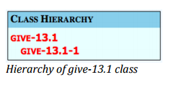
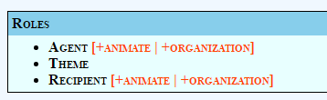
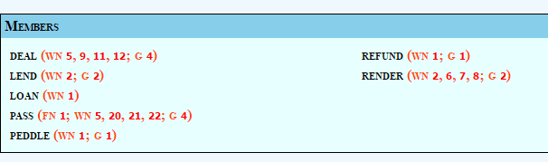
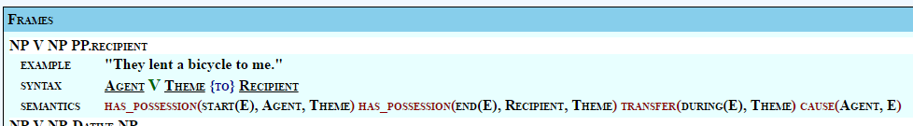
Components of a VerbNet Verb Class
Class Hierarchy – Contains the tree structure of a verb class including all parent classes and subclasses. Each individual class is hierarchical in the sense that classes may include one or more subclasses.
Members – Contains the list of verbs belonging to a specific class or subclass. Most verb members are mapped to entries in other lexical resources including FrameNet (Baker et al., 1998), WordNet (Miller, 1990; Fellbaum, 1998), and Xtag (XTAG Research Group, 2001).
Roles – Thematic roles refer to the semantic relationship between a predicate and its arguments. VerbNet makes use of a hierarchical thematic roleset, discussed in Section X. For each class, the roles that are thought to be core to the verb members’ behavior are listed.
Frames – The syntactic frames in VerbNet provide a description of the different surface realizations and diathesis alternations allowed for the members of the class. The Frames section consists of syntactic constructions, example sentences, and the semantic roles mapped to syntactic arguments. Semantic predicates are also depicted in this section, indicating how the participants are involved in the event.

Slide 127
(I went to the bank to deposit money)
from nltk.corpus import wordnet as wn
sent = ['I', 'went', 'to', 'the', 'bank', 'to', 'deposit', 'money', '.’]
for sent in wn.synsets('bank’)
print(sent.definition())
  Synset('bank.n.01') sloping land (especially the slope beside a body of water)
  Synset('bank.n.02') a long ridge or pile
  Synset('bank.n.03') an arrangement of similar objects in a row or in tiers
  Synset('bank.n.04') a supply or stock held in reserve for future use (especially in emergencies)
from nltk.wsd import lesk
print(lesk(sent, 'bank', 'n’))
Synset('savings_bank.n.02')

Slide 128
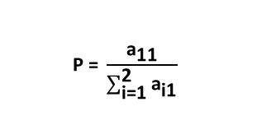
Precision: this is a factor to measure how much of the MCKSN model’s guess was correct (Grishman & Sundheim, 1996).
Based on the first scaling technique, precision was calculated as follows in Equation 6.14:
$$\text{P}\text{ = }\frac{{\text{a}}_{\text{11}}}{\sum_{\text{i}\text{=1}}^{\text{2}}{{\text{a}}_{\text{i}\text{1}}}}$$

Slide 129
Cognitive Domain : This domain includes content knowledge and the development of intellectual skills. This includes the recall or recognition of specific facts and concepts that serve developing intellectual abilities and skills. There are six major categories, starting from the simplest behavior (remembering facts) to the most complex (creating).
Affective Domain: The Affective domain includes feelings, values, appreciation, enthusiasms, motivations, and attitudes.
Example: Participates in class discussions.
Gives a presentation.
psychomotor domain includes physical movement, coordination, and use of the
motor-skill areas. Example : Adjusts heat of stove to correct temperature by smell and taste of food.

Slide 130
SVD - Example
A = U Σ V^{T} - example:
retrieval
inf.
lung
data
brain
CS
=
x
x
MD

Slide 131
SVD - Example
A = U Σ V^{T} - example:
retrieval
CS-concept
inf.
lung
MD-concept
data
brain
CS
=
x
x
MD

Slide 132
SVD - Example
doc-to-concept
similarity matrix
A = U Σ V^{T} - example:
retrieval
CS-concept
inf.
lung
MD-concept
data
brain
CS
=
x
x
MD

Slide 133
SVD - Example
A = U Σ V^{T} - example:
retrieval
inf.
‘strength’ of CS-concept
lung
data
brain
CS
=
x
x
MD

Slide 134
SVD - Example
A = U Σ V^{T} - example:
term-to-concept
similarity matrix
retrieval
inf.
lung
data
brain
CS-concept
CS
=
x
x
MD

Slide 135
SVD - Example
A = U Σ V^{T} - example:
term-to-concept
similarity matrix
retrieval
inf.
lung
data
brain
CS-concept
CS
=
x
x
MD

